Slide 1
Week 2: Advanced SQL & Analytical Metrics & Functions
Day 4 : joins, sub-queries & cte
Practical Join examples.
Writing Subqueries in SELECT, WHERE, and FROM
CTEs for Improved Readability

Slide 2
Analytics tip of the day
Understand your efforts and their impact.
Time Taken
Perceived effort
Time Taken
Perceived effort
Time Taken
Perceived effort
Perceived effort
Time Taken
Data engineering
Data modelling
Data analytics
Story telling
Lowest
Impact on Decision Making
Highest

Slide 3
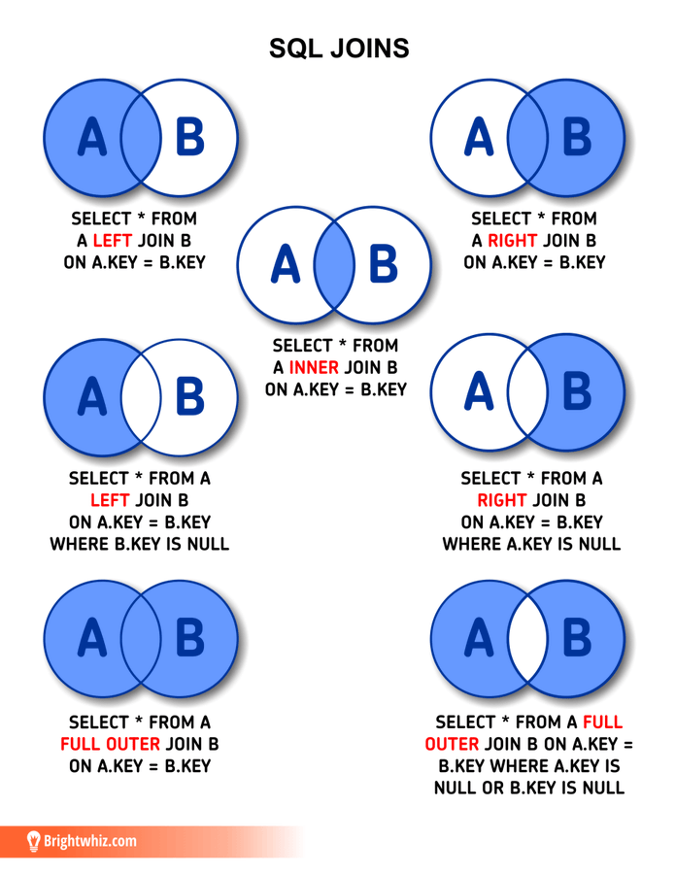
Joins
LEFT join : Get all data from left table and matching data from right.
Right join : Get all data from right table and matching data from left.
Inner join : Get only matching data between both tables.
Full join : Get all data

Slide 4
Hands on class activity
Write a query to retrieve the EnglishProductName from DimProduct and its SalesAmount from FactInternetSales,showing only products that have sales.
Modify the previous query to show all products, even if they have no sales. If a product has no sales, SalesAmount should show as NULL.
Now Calculate Total Sales of the all the products along with their ProductID and Name.

Slide 5
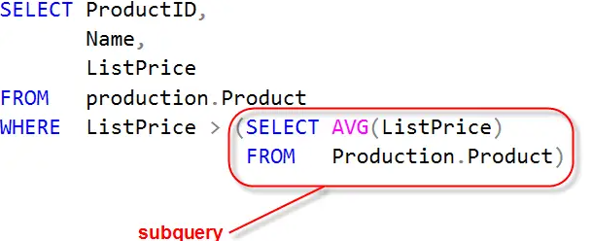
sub-queries
A subquery is a query inside another query. It is used to:
Retrieve data for the main query
Filter results dynamically
Calculate values before the main query runs

Slide 6
sub-queries
Subqueries are also called “nested queries” or “inner queries,” while the SQL statement containing the subquery is typically referred to as an “outer query.”

Slide 7
sub-queries
When to Use a Subquery in SQL
SQL subqueries let you nest queries within other queries, making data retrieval more dynamic and efficient. These make them ideal for the following scenarios:
Filtering data: Use subqueries in WHERE or HAVING clauses to filter results based on another query.
Aggregations on groups: Compute summary statistics with aggregate functions (e.g., AVG(), MIN(), etc.) within a subquery and use them in the main query.
Joins alternative: When a JOIN would complicate the query, you might be able to a subquery to get the same results.
Checking existence: Use EXISTS or NOT EXISTS with subqueries to verify data presence.
Generating derived tables: Use subqueries in the FROM clause to create derived tables.

Slide 8
sub-queries
Subqueries are also called “nested queries” or “inner queries,” while the SQL statement containing the subquery is typically referred to as an “outer query.”
They normally exists in three main places :
SELECT
WHERE
FROM
A few practical examples.

Slide 9
Sub-queries hands on class activity
Retrieve the product categories where the total sales are higher than the average category sales.
List the top 10 customers by total sales amount, using a subquery in FROM clause.
Find customers who have spent above the average sales amount. (Bonus : Try to calculate how much % more or less the customers spent, Formula :(Customer AVG / Overall AVG)*100)

Slide 10
What metrics are available in our dataset
Free hand exploration

Slide 11
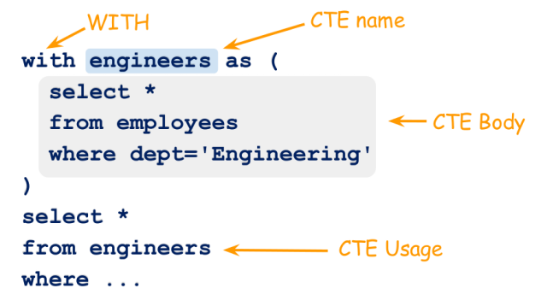
Common table expressions (cte)
Common Table Expressions (CTE) are a temporary result set that is returned by a single statement to be used further within the same statement. As it is a temporary result, it is not stored anywhere and does not consume disk space. However, you can reference it in the same manner as any table within the same query.

Slide 12
Sub-query VS cte
Why is CTE Better?
Easier to read and debug.
Can be referenced multiple times within the same query.
The WITH clause allows separation of logic for better organization.

Slide 13
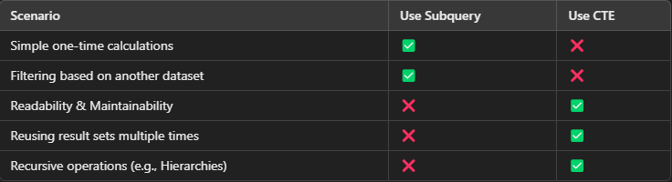
Sub-query VS cte
Where to use what?

Slide 14
THANKS
Does anyone have any questions?
Please keep this slide for attribution.

Slide 15
Haziq zahid
Sql instructor

Slide 16
About me
BSc Computer Science
dATA aNALYST
mSC dATA SCIENCE
pRODUCT ANALYST
2016-2020
FAST, Pakistan
2020-2022
Afiniti & Retailo, Pakistan
2022-2023
Middlesex University, UK
2024-Present
Holland & Barrett, UK

